Slide 1
Structured Query Language (SQL)
Chapter 6

Slide 2
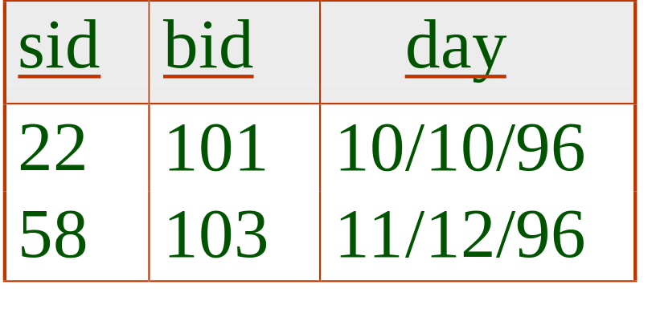
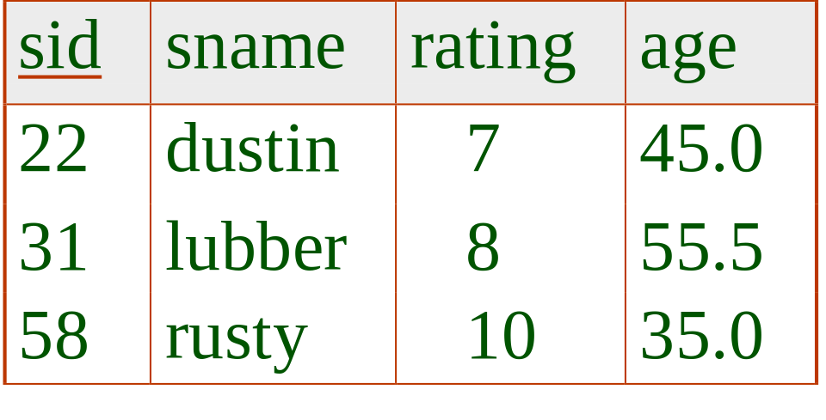
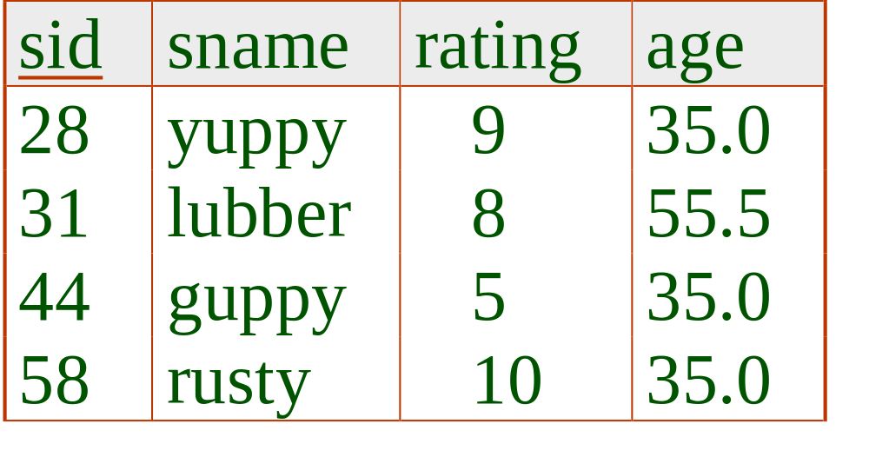
Example Instances
We will use these instances of the Sailors and Reserves relations in our examples.
R1
S1
B1
bid
bname
color
S2
101
interlake
blue
102
interlake
red
103
clipper
green
104
marine
red

Slide 3



What you want
SELECT [DISTINCT] target-list
FROM relation-list
WHERE qualification
Where you can find
Filter
relation-list A list of relation names (possibly with a range-variable after each name).
target-list A list of attributes of relations in relation-list
qualification Comparisons (Attr op const or Attr1 op Attr2, where op is one of >, <, >=,<=,=) combined using AND, OR and NOT.
DISTINCT is an optional keyword indicating that the answer should not contain duplicates. Default is that duplicates are not eliminated!

Slide 4
Conceptual Evaluation Strategy
Semantics of an SQL query defined in terms of the following conceptual evaluation strategy:
  Compute the cross-product of relation-list.
  Discard resulting tuples if they fail qualifications.
  Delete attributes that are not in target-list.
  If DISTINCT is specified, eliminate duplicate rows.
This strategy is probably the least efficient way to compute a query! An optimizer will find more efficient strategies to compute the same answers.

Slide 5
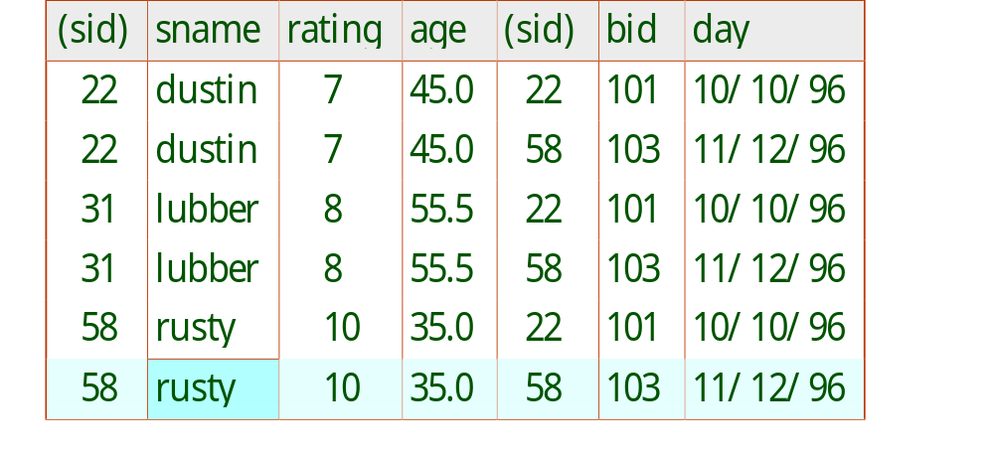
Example of Conceptual Evaluation
Find the name of the sailors who reserve a boat 103?
SELECT S.sname
FROM Sailors as S, Reserves as R
WHERE S.sid=R.sid AND R.bid=103

Slide 6
Using Aliases
In where condition, one can put Sailors as S instead of Sailors.
This means that we can use both Sailors and S to refer to the table.
Helpful shorthand to save time.
Useful if we want to refer to the first and second copy of a table.

Slide 7
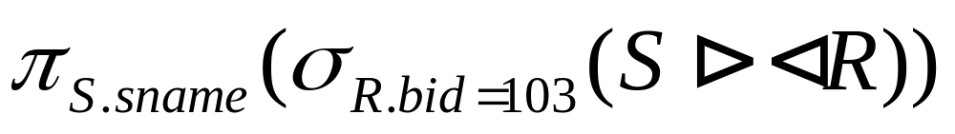
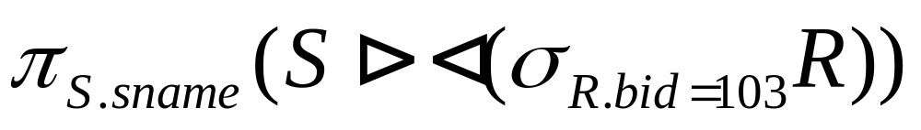
Example of Conceptual Evaluation
SELECT DISTINCT S.sname
FROM Sailors as S, Reserves as R
WHERE S.sid=R.sid AND R.bid=103

Slide 8
A Note on Range Variables
Really needed only if the same relation appears more than once in the FROM clause. The previous query can also be written as:
SELECT S.sname
FROM Sailors S, Reserves R
WHERE S.sid=R.sid AND bid=103
OR
SELECT sname
FROM Sailors, Reserves
WHERE Sailors.sid=Reserves.sid
AND bid=103

Slide 9
A Note on Range Variables
SELECT S.sid
FROM Sailors AS S, Boats AS B1, Reserves AS R1,
Boats AS B2, Reserves AS R2
WHERE S.sid=R1.sid AND R1.bid=B1.bid
AND S.sid=R2.sid AND R2.bid=B2.bid
AND B1.color='red' AND B2.color='green'
SELECT S.sid
FROM Sailors S, Boats B1, Reserves R1,
Boats B2, Reserves R2
WHERE S.sid=R1.sid AND R1.bid=B1.bid
AND S.sid=R2.sid AND R2.bid=B2.bid
AND B1.color='red' AND B2.color='green'

Slide 10
Find the sid of sailors who’ve reserved a red boat
SELECT R.sid
FROM Boats as B, Reserves as R
WHERE R.bid=B.bid AND B.color = 'red'
Query contains a join of two tables (cross product, selection, projection), followed by a selection on the color of boats
If we wanted the name of the sailors, then we must include the Sailors relation as well
Why?

Slide 11
Find the name of sailors who’ve reserved a red boat
SELECT DISTINCT S.sname
FROM Sailors as S, Boats as B, Reserves as R
WHERE S.sid=R.sid AND R.bid=B.bid AND B.color = 'red'
Query contains a join of three tables, followed by a selection on the color of boats

Slide 12
Find the rating of sailors who’ve reserved a green boat
SELECT S.rating
FROM Sailors as S, Boats as B, Reserves as R
WHERE S.sid=R.sid AND R.bid=B.bid AND B.color = 'green'
Query contains a join of three tables, followed by a selection on the color of boats

Slide 13
Find sailors who’ve reserved at least one boat
SELECT S.sid
FROM Sailors as S, Reserves as R
WHERE S.sid=R.sid
SELECT DISTINCT S.sid
FROM Sailors as S, Reserves as R
WHERE S.sid=R.sid
Query contains a join of two tables
Would adding DISTINCT to this query make a difference? (yes, why?)

Slide 14
Joins (remember, equi-join eliminates fields)
select *
from Sailors left join Reserves on
Sailors.sid = Reserves.sid
left can be substituted with right or full (it is all outer join)
No full outer joins in MySQL!!!
select *
from sailors inner join reserves
on sailors.sid=reserves.sid
select * from sailors natural join reserves

Slide 15
Expressions and Strings
SELECT S.age, S.age-5 AS age1
FROM Sailors as S
WHERE S.sname LIKE 'B_%';
Illustrates use of arithmetic expressions and string pattern matching: Find triples (of ages of sailors and second field defined by expression) for sailors whose names begin with B and contain at least two characters.
AS is a way to rename fields in result.
LIKE is used for string matching. `_’ stands for any one character and `%’ stands for 0 or more arbitrary characters.

Slide 16
Find sid’s of sailors who’ve reserved a red or a green boat
SELECT DISTINCT S.sid
FROM Sailors S, Boats B, Reserves R
WHERE S.sid=R.sid AND R.bid=B.bid
AND (B.color='red' OR B.color='green')
UNION: Can be used to compute the union of any two union-compatible sets of tuples (which are themselves the result of SQL queries).
If we replace OR by AND in the first version, what do we get?
MySQL does not support difference and intersection
SELECT S.sid
FROM Sailors S, Boats B, Reserves R
WHERE S.sid=R.sid AND R.bid=B.bid AND B.color= 'red'
UNION
SELECT S.sid
FROM Sailors S, Boats B, Reserves R
WHERE S.sid=R.sid AND R.bid=B.bid
AND B.color= ' green '

Slide 17
UNION vs UNION ALL
UNION eliminates duplicates in the result
UNION ALL operates on bags, no duplicate elimination
there is all INTERSECT ALL, EXCEPT ALL (but not in MySQL)

Slide 18
Find names of sailors who’ve reserved a boat named
‘yellowboat or a boat named ‘purpleboat’
SELECT S.sname
FROM Sailors S, Boats B, Reserves R
WHERE S.sid=R.sid AND R.bid=B.bid
AND B.bname='yellowboat'
UNION
SELECT S.sname
FROM Sailors S, Boats B, Reserves R
WHERE S.sid=R.sid AND R.bid=B.bid
AND B.bname='purpleboat'
SELECT DISTINCT S.sname
FROM Sailors S, Boats B, Reserves R
WHERE S.sid=R.sid AND R.bid=B.bid
AND (B.bname='yellowboat'
OR B.bname='purpleboat')

Slide 19
Find sid’s of sailors who’ve reserved a red and a green boat
SELECT DISTINCT S.sid
FROM Sailors S, Boats B1, Reserves R1,
Boats B2, Reserves R2
WHERE S.sid=R1.sid AND R1.bid=B1.bid
AND S.sid=R2.sid AND R2.bid=B2.bid
AND B1.color='red' AND B2.color='green'
SELECT DISTINCT *
FROM (SELECT S1.sid
FROM Sailors S1, Boats B1, Reserves R1
WHERE S1.sid=R1.sid AND R1.bid=B1.bid AND B1.color='red')
as X
NATURAL JOIN
(SELECT S2.sid
FROM Sailors S2, Boats B2, Reserves R2
WHERE S2.sid=R2.sid AND R2.bid=B2.bid AND
B2.color='green') as Y

Slide 20
Negation (Except not supported in MySQL)
Find the ids of sailors who have a reserved a green, but not a blue boat
SELECT S.sid
FROM Sailors S, Boats B, Reserves R
WHERE S.sid=R.sid AND R.bid=B.bid
AND B.color='green' and S.sid not in (
SELECT S.sid
FROM Sailors S, Boats B, Reserves R
WHERE S.sid=R.sid AND R.bid=B.bid
AND B.color='blue')

Slide 21
Nested Queries
Find names of sailors who’ve reserved boat #103:
SELECT DISTINCT S.sname
FROM Sailors S
WHERE S.sid IN (SELECT R.sid
FROM Reserves R
WHERE R.bid=103)
A very powerful feature of SQL: a WHERE clause can itself contain an SQL query! (Actually, so can FROM and HAVING clauses.)
To find sailors who’ve not reserved #103, use NOT IN.
To understand semantics of nested queries, think of a nested loops evaluation: For each Sailors tuple, check the qualification by computing the subquery.

Slide 22
Nested Queries (continued)
Another example:
Find names of sailors who’ve reserved a boat
on October 21, 2007
SELECT DISTINCT S.sname
FROM Sailors S
WHERE S.sid IN (SELECT R.sid
FROM Reserves R
WHERE R.day= '2007-10-21')

Slide 23
Nested Queries with Correlation
Find names of sailors who’ve reserved boat #2:
SELECT S.sname
FROM Sailors S
WHERE EXISTS (SELECT *
FROM Reserves R
WHERE R.bid=2 AND S.sid=R.sid)
EXISTS is another set comparison operator, like IN.
Allows test whether a set is nonempty

Slide 24
More on Set-Comparison Operators
We’ve already seen IN, EXISTS. Can also use NOT IN, NOT EXISTS. (will go over unique later)
Also available: op ANY, op ALL, where op ={>, >=, =,, <, <=}
Find sailors whose rating is greater than that of at least one of the sailors that is called lubber:
SELECT *
FROM Sailors S
WHERE S.rating > ANY (SELECT S2.rating
FROM Sailors S2
WHERE S2.sname='lubber')

Slide 25
More on Set-Comparison Operators
(continued)
Another example: find name of the sailors with the highest rating
What if there are sailors with null rating?
SELECT S.sname
FROM Sailors S
WHERE S.rating >= ALL (SELECT S2.rating
FROM Sailors S2)

Slide 26
More on Set-Comparison Operators
(continued)
Another example: find the sailors with the lowest rating
SELECT S.sname
FROM Sailors S
WHERE S.rating <= ALL (SELECT S2.rating
FROM Sailors S2)

Slide 27
Rewriting INTERSECT Queries Using IN
Find sid’s of sailors who’ve reserved both a red and a green boat:
SELECT distinct S.sid
FROM Sailors S, Boats B, Reserves R
WHERE S.sid=R.sid AND R.bid=B.bid AND B.color='red'
AND S.sid IN (SELECT S2.sid
FROM Sailors S2, Boats B2, Reserves R2
WHERE S2.sid=R2.sid AND R2.bid=B2.bid
AND B2.color='green')
Similarly, EXCEPT queries re-written using NOT IN.
Do example on board!

Slide 28
Division in SQL
(1)
SELECT S.sname
FROM Sailors S
WHERE NOT EXISTS
((SELECT B.bid
FROM Boats B)
EXCEPT
(SELECT R.bid
FROM Reserves R
WHERE R.sid=S.sid))
Find sailors who’ve reserved all boats:
Let’s do it the hard way, without EXCEPT:
(2)
SELECT S.sname
FROM Sailors S
WHERE NOT EXISTS (SELECT B.bid
FROM Boats B
WHERE NOT EXISTS (SELECT R.bid
FROM Reserves R
WHERE R.bid=B.bid
AND R.sid=S.sid))
Sailors S such that ...
there is no boat B without ...
a Reserves tuple showing S reserved B

Slide 29
Aggregate Operators
COUNT (*)
COUNT ( [DISTINCT] A)
SUM ( [DISTINCT] A)
AVG ( [DISTINCT] A)
MAX (A)
MIN (A)
single column
SELECT COUNT(*) as c
FROM Sailors S
SELECT S.sname
FROM Sailors S
WHERE S.rating= (SELECT MAX(S2.rating)
FROM Sailors S2)
SELECT AVG(S.age) as a
FROM Sailors S
WHERE S.rating=10
SELECT AVG ( DISTINCT S.age)
FROM Sailors S
WHERE S.rating=10
SELECT COUNT(rating) as c
FROM Sailors S
WHERE S.sname='Bob'

Slide 30
Count vs count distinct
count(rating) will count the number of tuples where
rating != null
count(*) will count the total number of tuples
count(1) does the same
count(distinct rating) will count the number of
distinct values for the rating attribute. Null doesn’t count as
a distinct value!

Slide 31
Aggregate Operators (continued)
Sum example: find the sum of all the ages of sailors, and the count, who have reserved boat #2
SELECT SUM(S.age) as sAge,
Count(S.sname) as cName
FROM Sailors S
WHERE EXISTS (SELECT *
FROM Reserves R
WHERE R.bid=2 AND S.sid=R.sid)

Slide 32
Find name and age of the oldest sailor(s)
SELECT S.sname, MAX(S.age)
FROM Sailors S
The first query is illegal! (We’ll look into the reason a bit later, when we discuss GROUP BY.)
The reason is that it not clear what names to be returned
SELECT S.sname, S.age
FROM Sailors S
WHERE S.age =
(SELECT MAX(S2.age) as age
FROM Sailors S2)

Slide 33
GROUP BY and HAVING
So far, we’ve applied aggregate operators to all (qualifying) tuples. Sometimes, we want to apply them to each of several groups of tuples.
Consider: Find the age of the youngest sailor for each rating level.
  In general, we don’t know how many rating levels exist and what the rating values for these levels are!
  Suppose we know that rating values go from 1 to 10; we can write 10 queries that look like this (!):
SELECT MIN (S.age)
FROM Sailors S
WHERE S.rating = i
For i = 1, 2, ... , 10:

Slide 34
Correct query
SELECT MIN(S.age) as min_age, rating
FROM Sailors S
GROUP BY rating

Slide 35
Queries With GROUP BY and HAVING
SELECT [DISTINCT] target-list
FROM relation-list
WHERE qualification
GROUP BY grouping-list
HAVING group-qualification
The target-list contains (i) attribute names (ii) terms with aggregate operations (e.g., MIN (S.age)).
  The target-list must be a subset of grouping-list. Intuitively, each answer tuple corresponds to a group, and these attributes must have a single value per group. (A group is a set of tuples that have the same value for all attributes in grouping-list.)

Slide 36
Conceptual Evaluation
The cross-product of relation-list is computed, tuples that fail qualification are discarded, `unnecessary’ fields are deleted, and the remaining tuples are partitioned into groups by the value of attributes in grouping-list.
The group-qualification is then applied to eliminate some groups. Expressions in group-qualification must have a single value per group!
  In effect, an attribute in group-qualification that is not an argument of an aggregate op also appears in grouping-list.
One answer tuple is generated per qualifying group.

Slide 37
Example
store | product | date | sale
1 | 1 | 1 | 10
1 | 1 | 2 | 15
1 | 2 | 1 | 20
1 | 2 | 2 | 25
1 | 3 | 1 | 5
1 | 3 | 2 | 10
2 | 1 | 1 | 100
2 | 1 | 2 | 150
2 | 2 | 1 | 200
2 | 2 | 2 | 250
2 | 3 | 1 | 50
2 | 3 | 2 | 100

Slide 38
Example
Select store, product, sum(sale) from R group by store, product
  1 1 25
  1 2 45
  1 3 15
  2 1 250
  2 2 450
  2 3 150
Select store, sum(sale) from R group by store, product ?
Select store, product, sum(sale) from R group by store ? <-should be invalid, it is not in MySQL

Slide 39

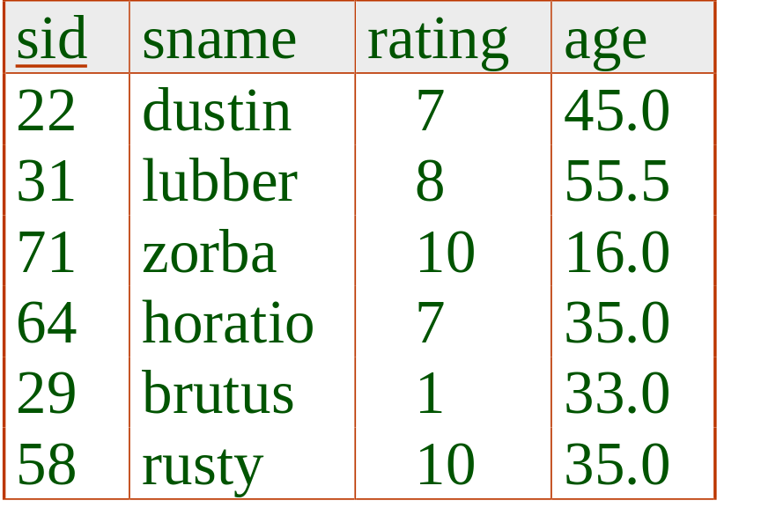
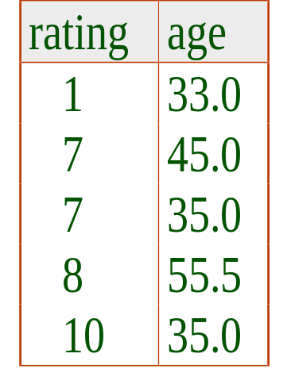
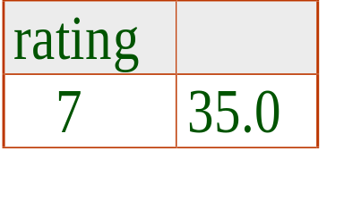
Find the age of the youngest sailor with age 18, for each rating with at least 2 such sailors
SELECT S.rating, MIN(S.age)
FROM Sailors S
WHERE S.age >= 18
GROUP BY S.rating
HAVING COUNT(*) > 1
Only S.rating and S.age are mentioned in the SELECT, GROUP BY or HAVING clauses; other attributes `unnecessary’.
2nd column of result is unnamed. (Use AS to name it.)
Answer relation

Slide 40
For each red boat, find the number of reservations for this boat
SELECT B.bid, COUNT(*) AS scount
FROM Sailors S, Boats B, Reserves R
WHERE S.sid=R.sid AND R.bid=B.bid AND B.color='red‘
GROUP BY B.bid
Grouping over a join of three relations.
What do we get if we remove B.color=‘red’ from the WHERE clause and add a HAVING clause with this condition?
What if we drop Sailors and the condition involving S.sid?

Slide 41
Find the age of the youngest sailor with age > 18, for each rating with at least 2 sailors (of any age)
SELECT S.rating, MIN(S.age)
FROM Sailors S
WHERE S.age > 18
GROUP BY S.rating
HAVING 1 < (SELECT COUNT(*)
FROM Sailors S2
WHERE S.rating=S2.rating)
Shows HAVING clause can also contain a subquery.
Compare this with the query where we considered only ratings with 2 sailors over 18!

Slide 42
Find those ratings for which the average age is the minimum over all ratings
Aggregate operations cannot be nested! WRONG:
SELECT S.rating
FROM Sailors S
WHERE S.age = (SELECT MIN (AVG (S2.age)) FROM Sailors S2)
Correct solution (in SQL/92):
CREATE TABLE TEMP (rating int, avgage int);
insert into TEMP
SELECT rating, AVG(age) AS avgage
FROM Sailors
GROUP BY rating;
SELECT rating, avgage FROM TEMP
WHERE avgage = (SELECT MIN(avgage)
FROM TEMP); DROP TABLE TEMP;

Slide 43
Using Views
CREATE VIEW TEMPVIEW as
SELECT rating, AVG(age) AS avgage
FROM Sailors
GROUP BY rating;
SELECT rating, avgage
FROM TEMPVIEW
WHERE avgage = (SELECT MIN(avgage) FROM TEMPVIEW);
DROP VIEW TEMPVIEW;

Slide 44
Using Temp Tables (Doesn’t work in MySQL)
Temp Tables exist only during current connection.
CREATE TEMPORARY TABLE T as
SELECT rating, AVG(age) AS avgage
FROM Sailors
GROUP BY rating;
SELECT rating, avgage
FROM T
WHERE avgage = (SELECT MIN(avgage) FROM T);
DROP TEMP TABLE T;

Slide 45
Strange queries
select 1
from S
what does it return?

Slide 46
Order query
select *
from Sailors
order by rating asc, sname asc

Slide 47
Top n query
select *
from Sailors
order by age asc
limit 2
What does it return?

Slide 48
Null Values
Field values in a tuple are sometimes unknown (e.g., a rating has not been assigned) or inapplicable (e.g., no spouse’s name).
  SQL provides a special value null for such situations.
The presence of null complicates many issues. E.g.:
  Special operators needed to check if value (is/is not) null.
  Is rating>8 true or false when rating is equal to null? What about AND, OR and NOT connectives?
  We need a 3-valued logic (true, false and unknown).
  Meaning of constructs must be defined carefully. (e.g., WHERE clause eliminates rows that don’t evaluate to true.)
  New operators (in particular, outer joins) possible/needed.

Slide 49
Integrity Constraints (Review)
An IC describes conditions that every legal instance of a relation must satisfy.
  Inserts/deletes/updates that violate IC’s are disallowed.
  Can be used to ensure application semantics (e.g., sid is a key), or prevent inconsistencies (e.g., sname has to be a string, age must be < 200)
Types of IC’s: Domain constraints, primary key constraints, foreign key constraints, general constraints.
  Domain constraints: Field values must be of right type. Always enforced.
Notes:
5

Slide 50
General Constraints
(no support in MySQL)
CREATE TABLE Sailors
( sid INTEGER not null,
sname VARCHAR(10),
rating INTEGER,
age REAL,
PRIMARY KEY (sid),
CHECK ( rating >= 1
AND rating <= 10 ))
Useful when more general ICs than keys are involved.
Can use queries to express constraint.
Constraints can be named.
CREATE TABLE Reserves
( sname VARCHAR(10),
bid INTEGER not null,
day DATE not null,
PRIMARY KEY (bid,day),
CONSTRAINT noInterlakeRes
CHECK (`Interlake’ <>
( SELECT B.bname
FROM Boats B
WHERE B.bid=bid)))
Notes:
8

Slide 51
Triggers
Trigger: procedure that starts automatically if specified changes occur to the DBMS
Three parts:
  Event (activates the trigger)
  Condition (tests whether the triggers should run)
  Action (what happens if the trigger runs)

Slide 52
Trigger Example
CREATE TRIGGER `testme`
BEFORE INSERT ON `sailors`
FOR EACH ROW
BEGIN
IF new.rating > 10 THEN
SIGNAL sqlstate '12345';
END IF;
END

Slide 53
Trigger for updates
CREATE TRIGGER updates
BEFORE UPDATE ON sailors
FOR EACH ROW
BEGIN
if(new.rating > 10 or new.rating < 1)
then
signal sqlstate '45000';
end if;
END

Slide 54
Second example
CREATE TRIGGER updates
BEFORE UPDATE ON sailors
FOR EACH ROW
BEGIN
if(new.rating > old.rataing) then
signal sqlstate '45000';
end if;
END

Slide 55
Audit trigger
create trigger audittrigger
after insert on bankAccount
for each row begin
insert into audit values('insert',new.a);
end

Slide 56
Summary
SQL was an important factor in the early acceptance of the relational model; more natural than earlier, procedural query languages.
Relationally complete; in fact, significantly more expressive power than relational algebra.
Even queries that can be expressed in RA can often be expressed more naturally in SQL.
Many alternative ways to write a query; optimizer should look for most efficient evaluation plan.
  In practice, users need to be aware of how queries are optimized and evaluated for best results.

Slide 57
Summary (Contd.)
NULL for unknown field values brings many complications
SQL allows specification of rich integrity constraints
Triggers respond to changes in the database

